Slide 1

University Database System
Ubaid Bin Waris | 2212416
Mushaid Hussain | 2212408
Muhammad Salman | 2212400
Jehanzeb Khalid | 2212391

Slide 2
Table of contents
01
04
02
05
03
06
Introduction
Data Manipulating
Implementations of Database
ER Diagram
Database Schema
Conclusion

Slide 3

Introduction
The University Database System is designed to efficiently manage essential academic data within a structured relational database. It organizes crucial information, including courses, classrooms, faculty, and schedules, all while enhancing data accessibility and maintaining data integrity. By reducing redundancy, the system ensures consistency across various university functions and prevents errors in data entry. With robust CRUD operations, administrators can easily create, retrieve, update, and delete records as needed. The database also supports complex queries, allowing for comprehensive reporting on classroom usage, faculty schedules, and course assignments.

Slide 4
Implementation of project
Table Structure: Each table in the schema represents a key entity (e.g., Students, Faculty, Courses, Departments) and defines the attributes relevant to that entity.
Primary Keys: Each table includes a primary key to uniquely identify each record (e.g., StudentID for Students, CourseID for Courses), ensuring data integrity.
Foreign Keys: Relationships between tables are established through foreign keys (e.g., StudentID in the Enrollments table linking to the Students table), enabling data referencing across entities.
Relationships: The schema outlines one-to-many and many-to-many relationships (e.g., one department can have many courses, and students can enroll in multiple courses) to accurately reflect real-world connections.
Constraints and Integrity: The schema enforces data constraints (e.g., NOT NULL, UNIQUE) to maintain referential integrity and ensure valid data entries throughout the system.

Slide 5
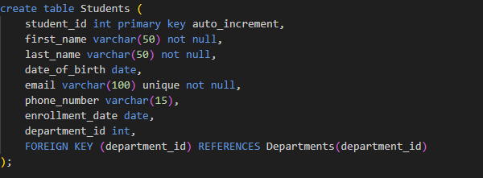
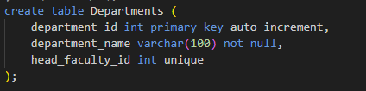
Database Schema
Departments Table
Stores information about departments within the university, including a unique department ID and the head of the department.
Student Table
Contains information about students, including personal details and the department they're enrolled in.

Slide 6
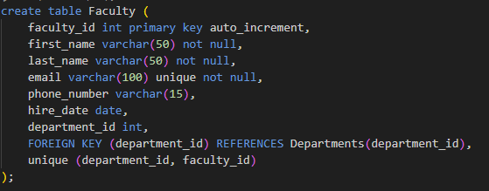
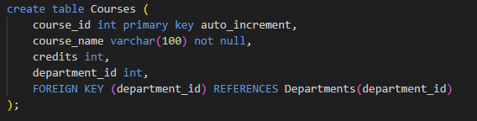
Faculty Table
Contains information about faculty members, including personal details and the department they are associated with.
Course Table
Stores details about courses, including the department offering the course.

Slide 7
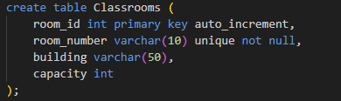
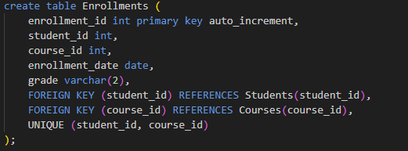
Enrollment Table
Tracks course enrollments for students, including grades. This is a weak entity dependent on both Students and Courses.
Classroom Table
Manages classrooms, including unique room numbers and attributes like building and capacity.

Slide 8
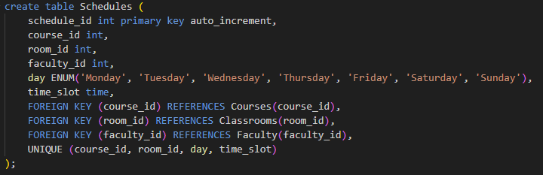
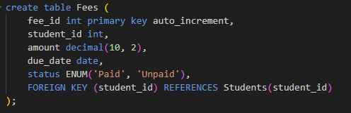
Schedules Table
Schedules classes, linking them to courses, classrooms, and faculty members. This is a weak entity dependent on both Courses and Faculty.
Fees Table
Tracks fees for each student, with status indicating whether fees are paid or unpaid.

Slide 9
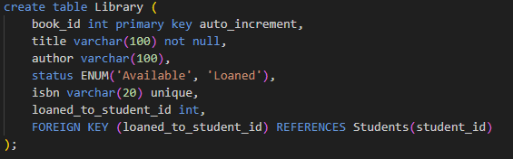
Library Table
Manages books in the university’s library, including loaned books and their status.

Slide 10

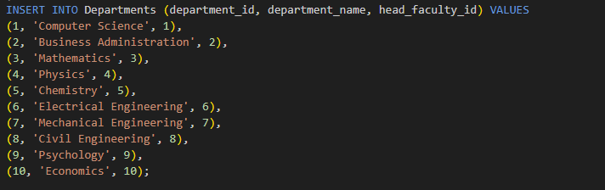
Data Manipulating CRUD Operations
Insert Data
To populate tables with initial data, INSERT INTO commands are used. Each table requires specific values based on its attributes and foreign key dependencies.
Update Data
The UPDATE command allows modifying existing data in the tables, commonly used for updating contact details or course assignments.

Slide 11

Delete Data
To delete data from the University Database System, you can use the SQL DELETE statement, specifying the table and conditions for the records to be removed. For example, to delete a student record:

Slide 12
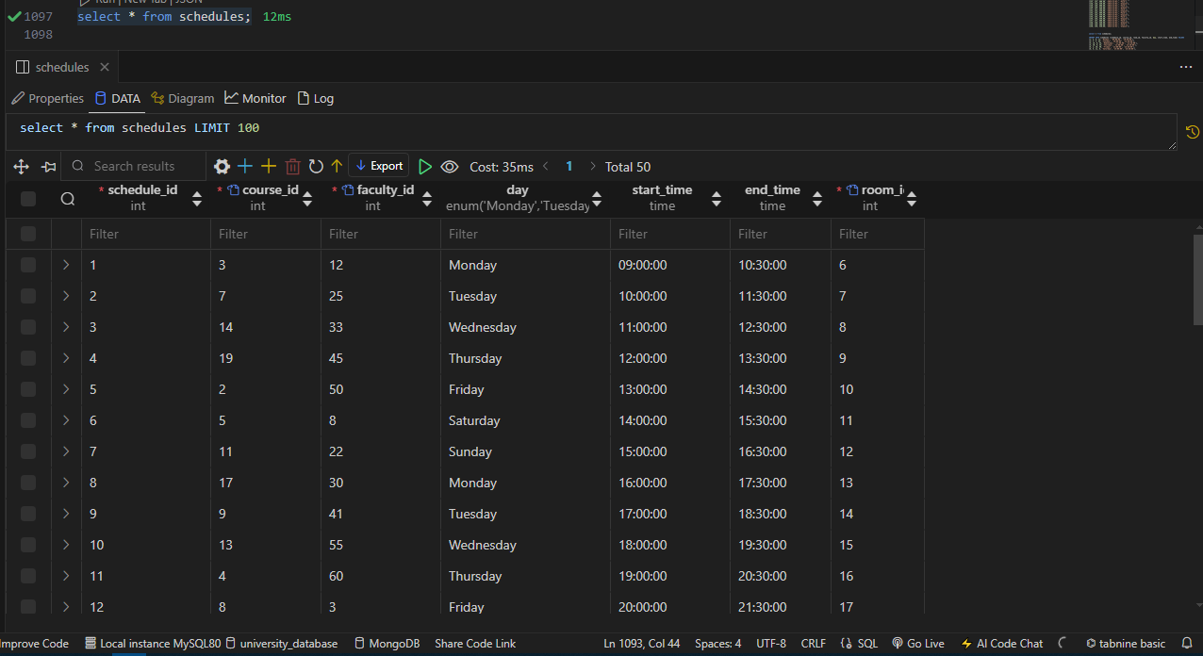
Select Data
The SELECT command retrieves data from tables, often with JOINs to connect related tables. This is used for displaying information, generating reports, and validating data integrity.

Slide 13
Schema Relationships and Constraints
Primary Keys Each table has a primary key (department_id, student_id, faculty_id, course_id, etc.) to uniquely identify records.
Foreign Keys Foreign key constraints ensure that relationships between tables (like department_id in Faculty and Students) maintain data integrity.
Unique Constraints Unique constraints, such as on email in Students and Faculty, ensure that certain attributes remain distinct across records.
Enumerated Data Types: For attributes with limited values (e.g., status in Library and Fees tables), ENUM data types improve data accuracy and constraints.

Slide 14
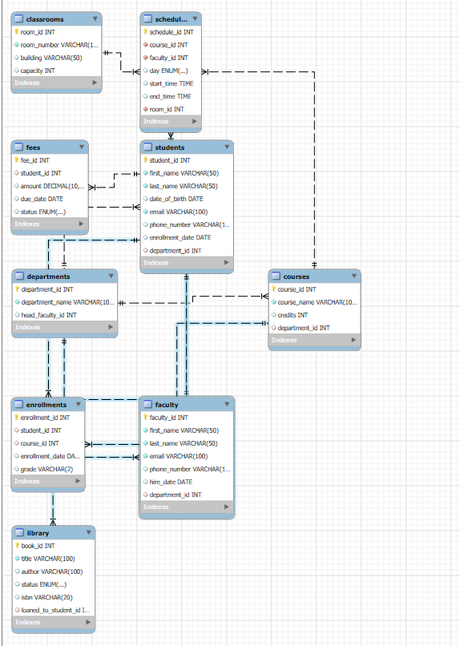
ER Diagram
ER DIAGRAM

Slide 15
Conclusion
In conclusion, the University Database System serves as a crucial tool for effectively managing and organizing essential university data. Its well-structured schema, robust SQL functionality, and emphasis on data integrity ensure that university operations are conducted smoothly and efficiently. By demonstrating core database principles and facilitating seamless interactions between various entities, this system not only meets current administrative needs but also lays a solid foundation for future enhancements. Ultimately, it is an invaluable asset that enhances academic management and supports the ongoing growth and development of the university.

Slide 16
Thanks!
Do you have any questions?

